Slide 1
Automated Variable Selection of Gamma-Ray Responses by Utilizing LASSO and Elastic Net
Vincent DiNova
NC State University
Schubert Review
April 2-3, 2019
Manhattan, KS

Slide 2
Agenda
Prompt Gamma Neutron Activation Analysis (PGNAA)
Neutron
Gamma
Detector Response
Library generation
Monte Carlo Library Least Squares (MCLLS) fitting
Supervised Machine Learning - Model Selection
Regularization methods (LASSO and Elastic Net)
Complete flow chart of fitting
Results
Continuing research

Slide 3
Neutron Interactions
γ
INELASTIC SCATTERING
γ
THERMAL CAPTURE
NEUTRON ACTIVATION

Slide 4
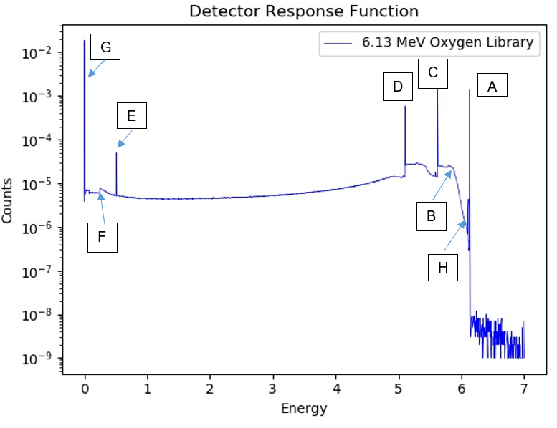
Detector Physics and Features
MCNP Simulation
F8 Tally – energy deposition
“Perfect resolution”
Oxygen-16 activation (N-16 decay)
6.130 MeV photon
7.13 second half life
Oxygen-16 inelastic scatter
6.13 MeV prompt gamma

Slide 5
Library Generation
Extensive MCNP simulations
Center for Engineering Applications of Radioisotopes (CEAR) cluster – reduced run times from 1.5-3 days to ~1 hour
F8 tally for gamma detection
No GEB
Detector Response Function (DRF)
Response generated in a detector from incident radiation
Non-linearities resolved to treat problem as a linear combination of library inputs
Gaussian broadening fit of full width/half max using calibration sources
Energy to channel conversion (2nd order polynomial in the following examples)
Both of these will be upgraded by the work performed by Aaron Feinberg

Slide 6
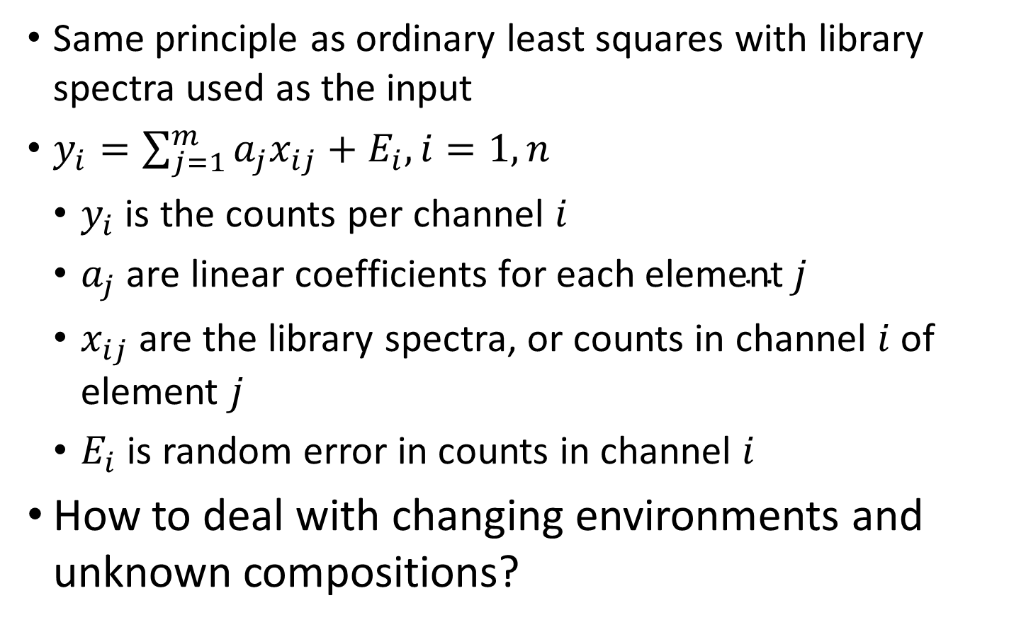
Monte Carlo Library Least Squares
Same principle as ordinary least squares with library spectra used as the input
$y_{i}=\sum_{j=1}^{m}{a_{j}x_{ij}+E_{i}, i=1,n}$
$y_{i}$ is the counts per channel $i$
$a_{j} \text{are} \text{linear} \text{coefficients} \text{for} \text{each} \text{element} j$
$x_{ij}$ are the library spectra, or counts in channel $i$ of element $j$
$E_{i}$ is random error in counts in channel $i$
How to deal with changing environments and unknown compositions?

Slide 7
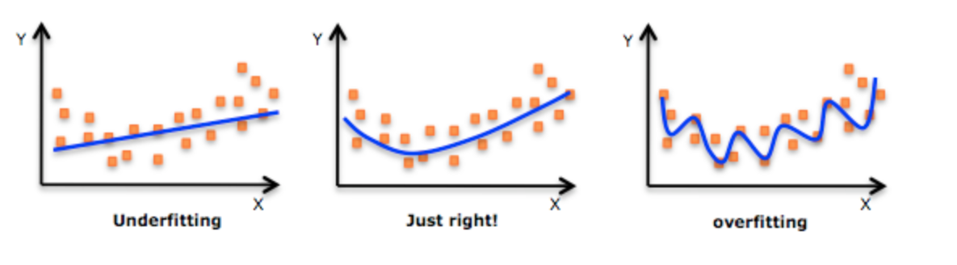
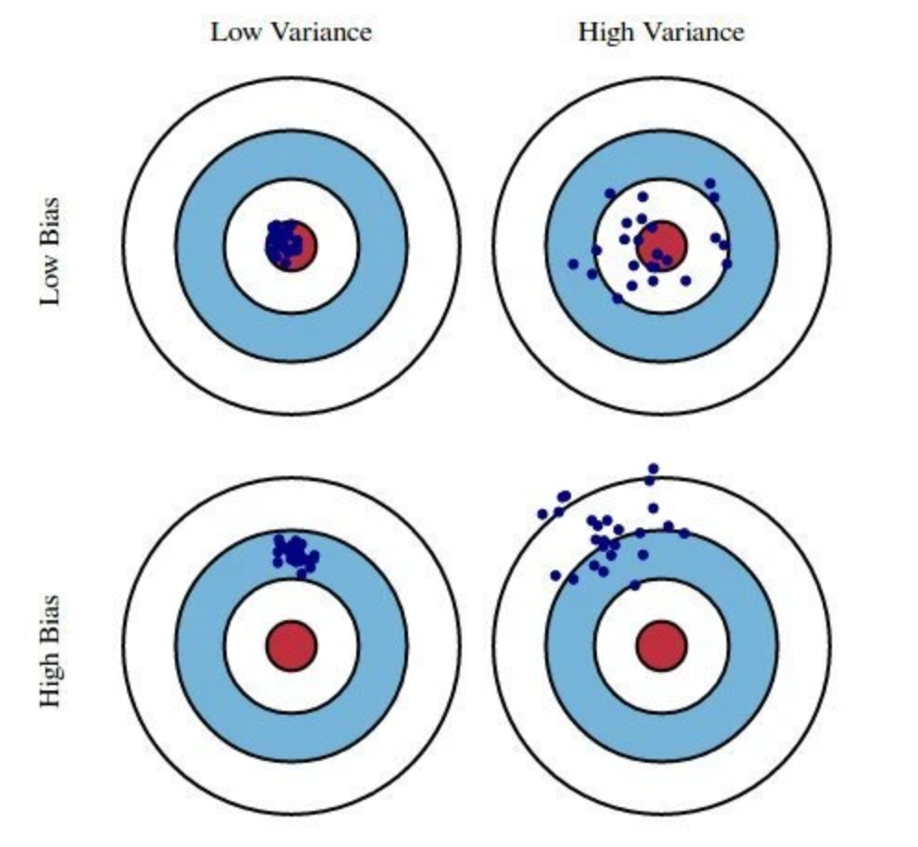
Supervised Machine Learning - Model Selection
Ordinary Least Squares traditionally suffers from overfitting
Too many model parameters
Model selection should have the right parameters to accurately predict/fit correct solution
Adding complexity to the model increases bias while reducing variance
Supervised machine learning variable selection techniques aim to minimize unnecessary bias and variance simultaneously by selecting the correct parameters

Slide 8
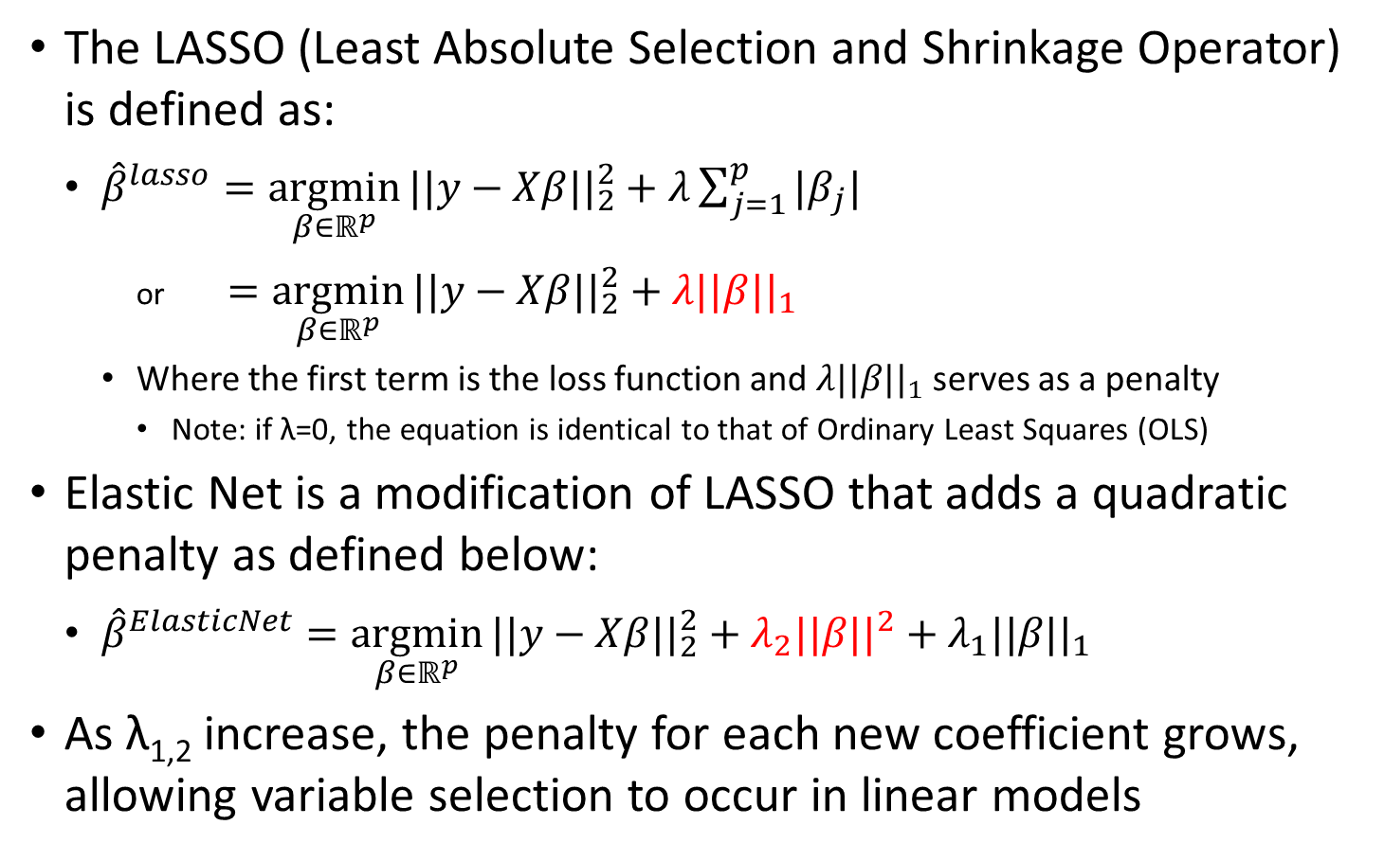
LASSO and Elastic Net
The LASSO (Least Absolute Selection and Shrinkage Operator) is defined as:
${\hat{β}}^{lasso}=\underset{β∈ℝ^{p}}{argmin}{||y−Xβ{||}_{2}^{2}+λ\sum_{j=1}^{p}{|β_{j}|}}$
or $=\underset{β∈ℝ^{p}}{argmin}{||y−Xβ{||}_{2}^{2}}+λ||β{||}_{1}$
Where the first term is the loss function and $λ||β{||}_{1}$ serves as a penalty
Note: if λ=0, the equation is identical to that of Ordinary Least Squares (OLS)
Elastic Net is a modification of LASSO that adds a quadratic penalty as defined below:
${\hat{β}}^{ElasticNet}=\underset{β∈ℝ^{p}}{argmin}{||y−Xβ{||}_{2}^{2}}+λ_{2}||β{||}^{2}+λ_{1}||β{||}_{1}$
As λ_{1,2} increase, the penalty for each new coefficient grows, allowing variable selection to occur in linear models

Slide 9
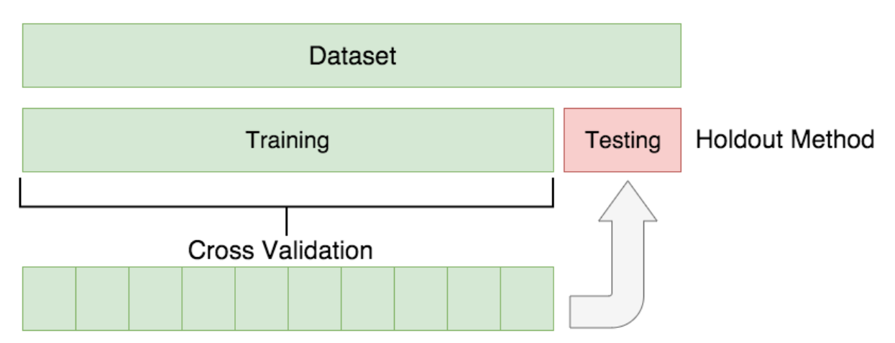
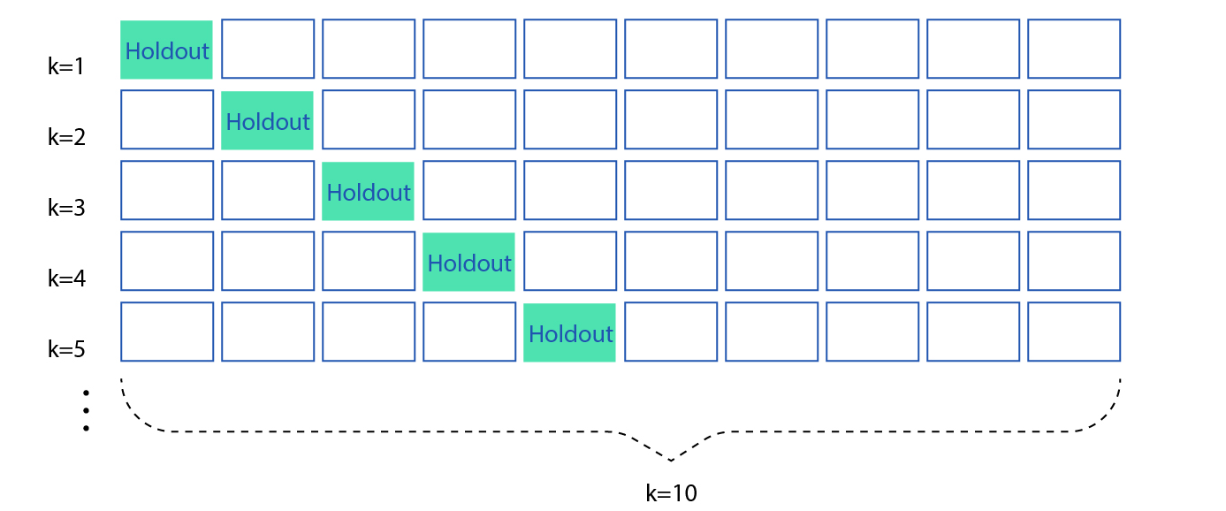
Cross Validation
Each method relies on test/train split to tune model parameters
This step introduces bias from selecting some data over others (random)
Cross validation performs the test/train split multiple times, reducing random bias from the model training
Trade off - extra computing time

Slide 10
Full Run Flow Chart
Simulated and experimental data is generated
Each set is processed
Nonlinearities removed
Prompt/delayed responses are extracted
Test/train split data for model selection
Variable selection through LASSO or Elastic Net remove unnecessary model parameters and provides initial guesses
Final ordinary least squares fitting to reduce bias from model selection procedure
Experimental Data Collection
MCNP Library Generation
Process Data
Account for Nonlinearity
Test/Train Split
Perform Variable Selection
Ordinary Least Squares Fitting

Slide 11
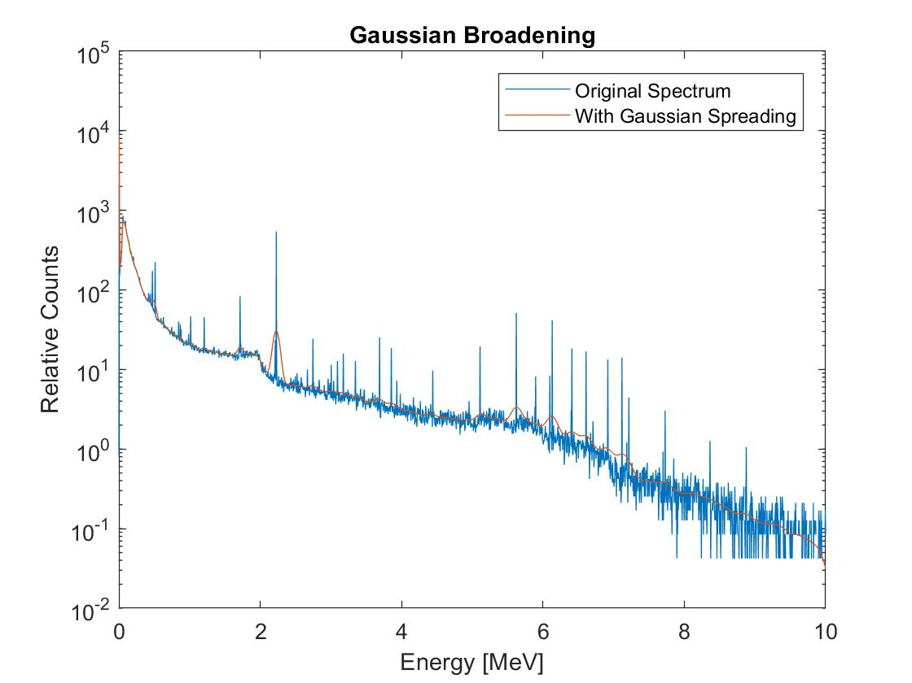
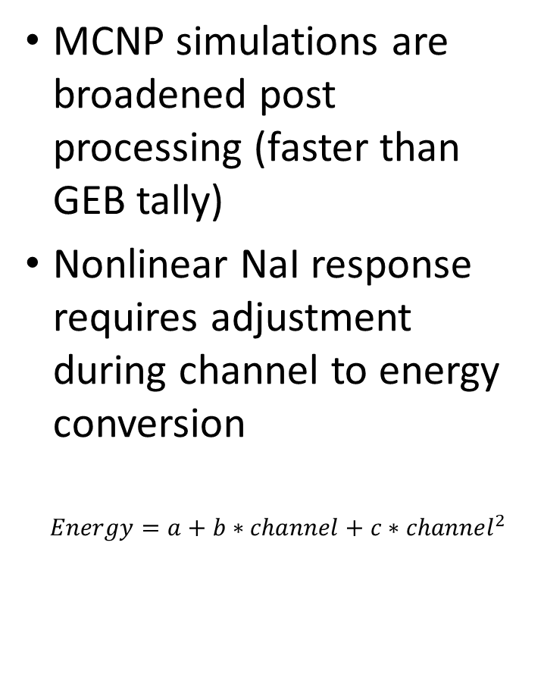
Processing of Data
MCNP simulations are broadened post processing (faster than GEB tally)
Nonlinear NaI response requires adjustment during channel to energy conversion
$$Energy=a+b∗channel+c∗{channel}^{2}$$

Slide 12
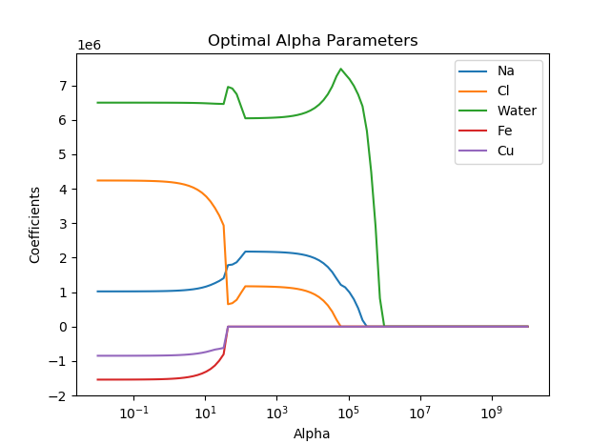
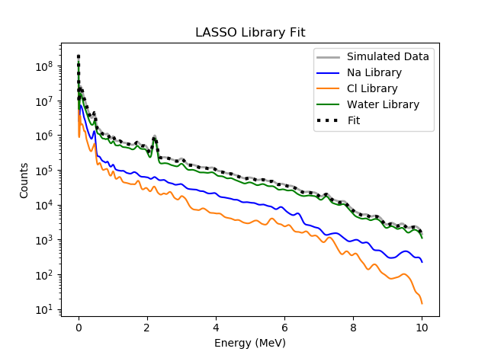
LASSO Simulated Example
Note: 5 libraries are used. Fe and Cu do not contribute to the total spectrum, are given a 0 contribution and selected out of the final model.

Slide 13
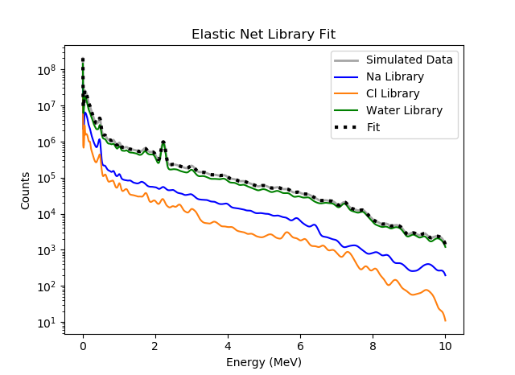
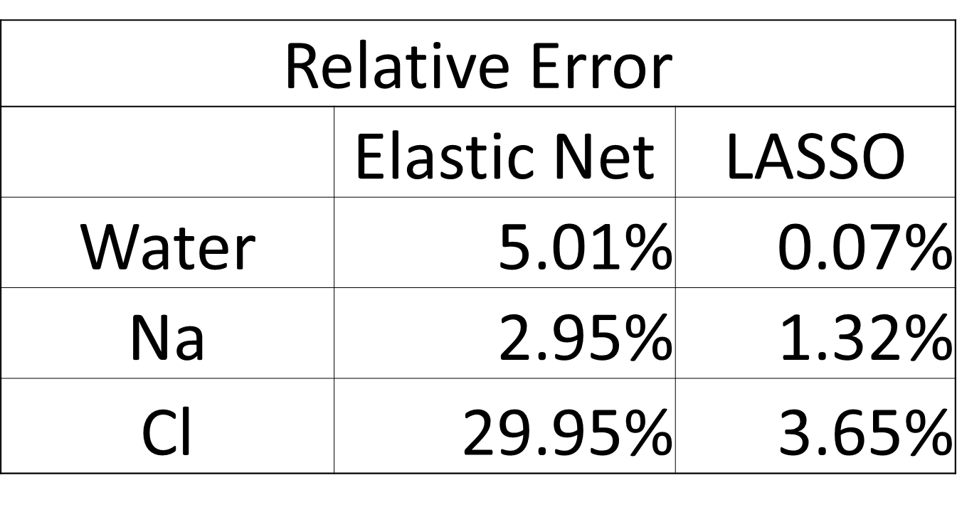
Elastic Net Simulation and Comparison

Slide 14
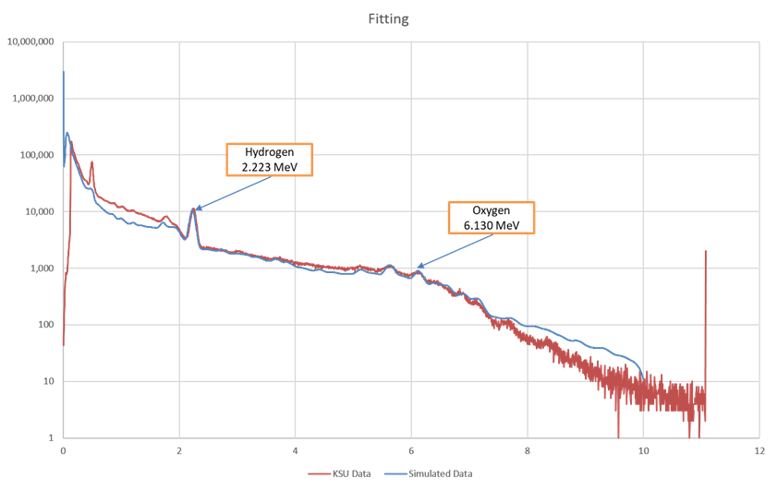
First Experimental Fit - Water

Slide 15
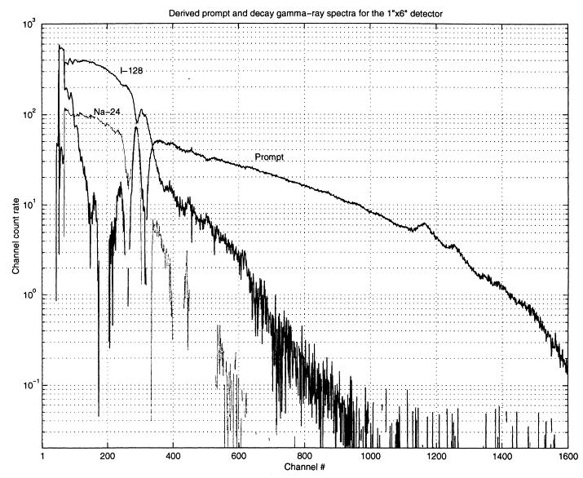
Gardner and Mayo, 2000
Activated NaI detector using NC State PULSTAR reactor
Detector activation is common during PGNAA
I-128 more sensitive than Na-24
β particle emission difficult to simulate using MCNP

Slide 16
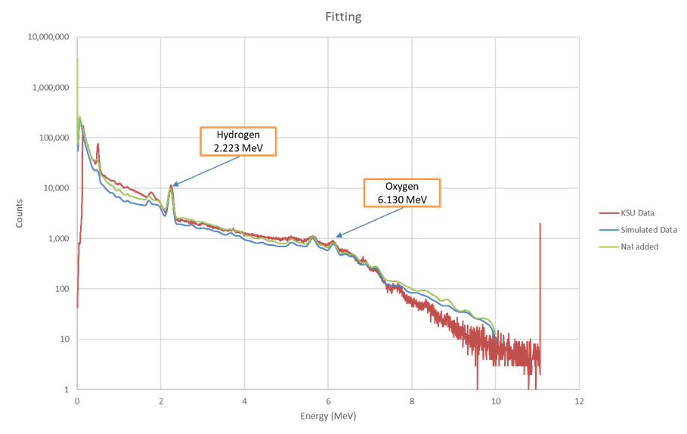
Results With NaI Activation - Water

Slide 17
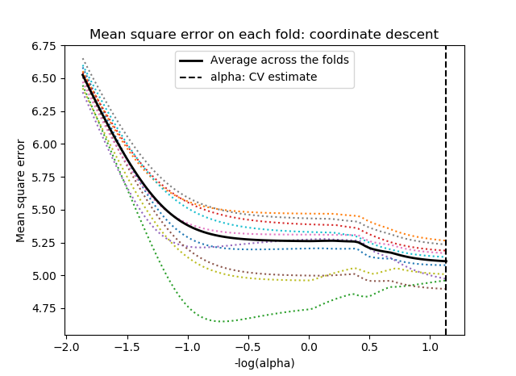
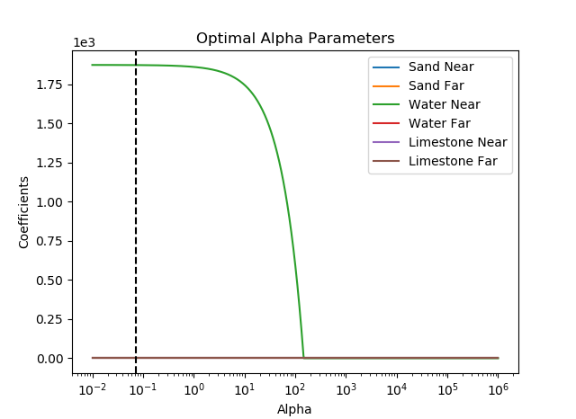
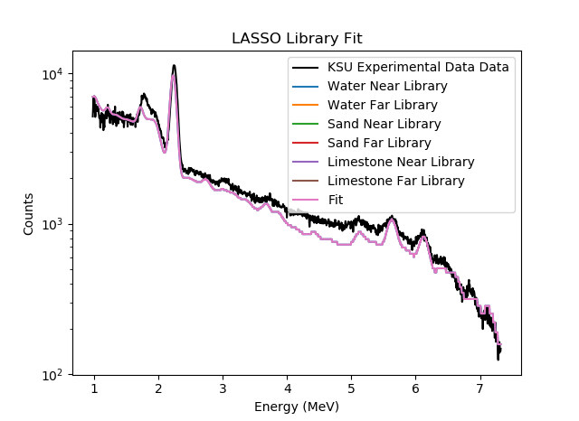
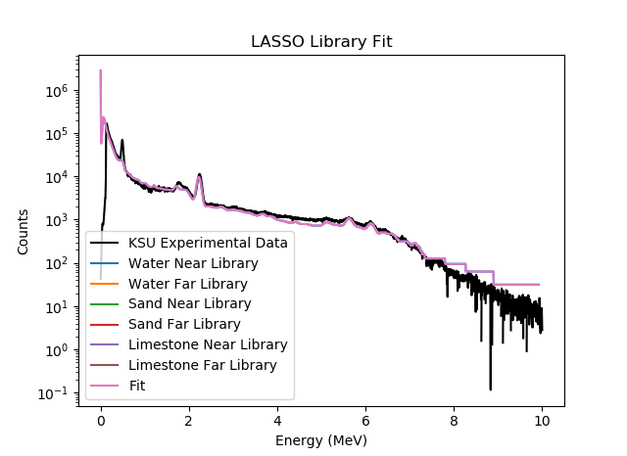
LASSO Water Experiment Example

Slide 18
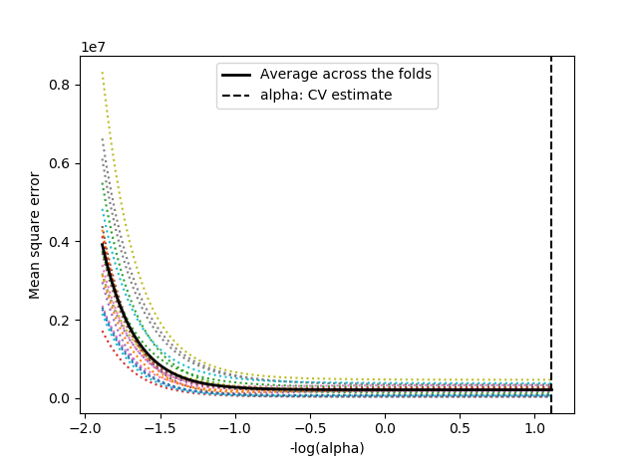
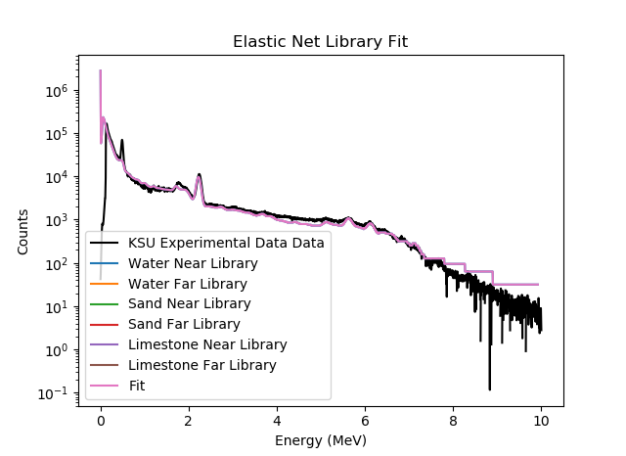
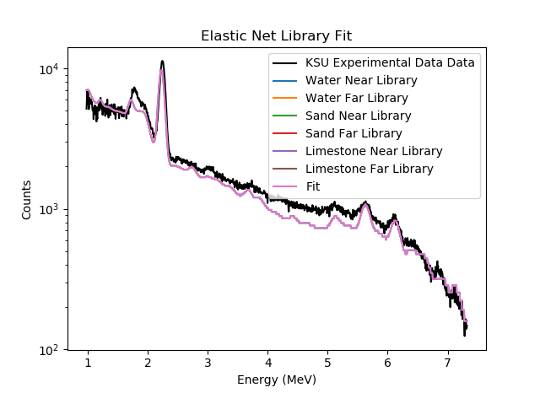
Elastic Net Water Experiment Example

Slide 19
Water Trial – Full Fit
Hydrogen 2.223 MeV
Oxygen 6.130 MeV

Slide 20
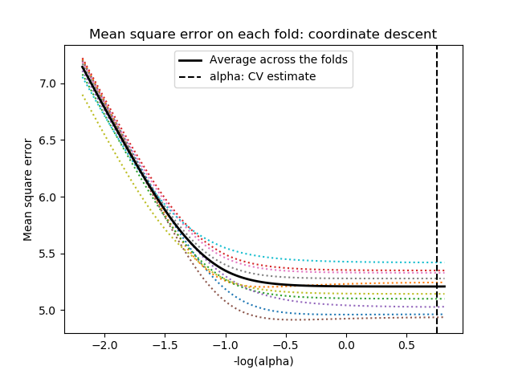
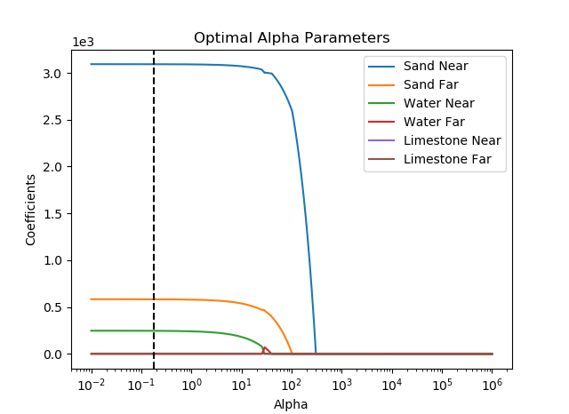
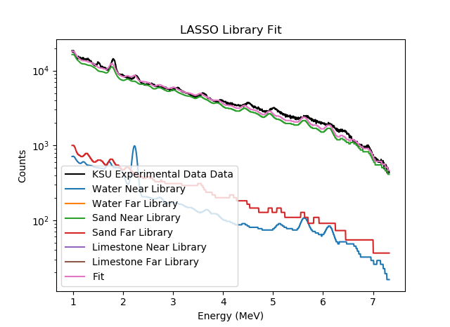
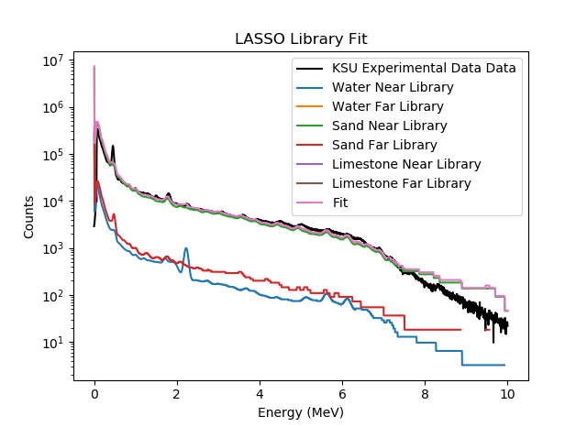
LASSO Sand Experiment Example

Slide 21
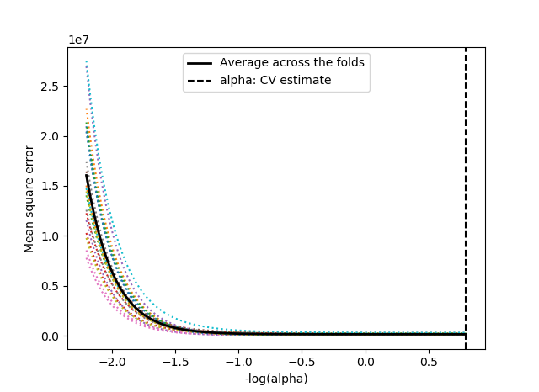
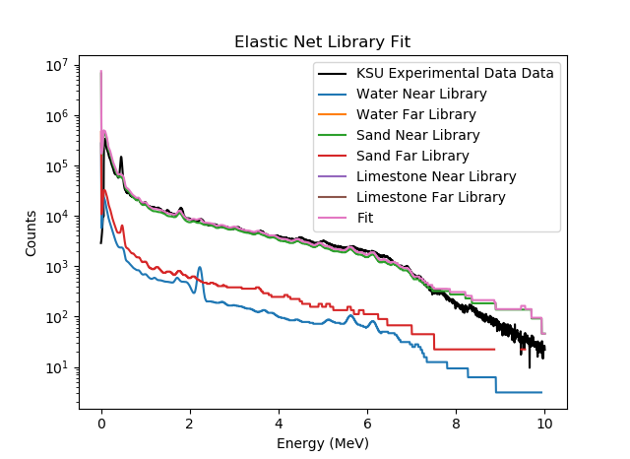

Elastic Net Sand Experiment Example

Slide 22
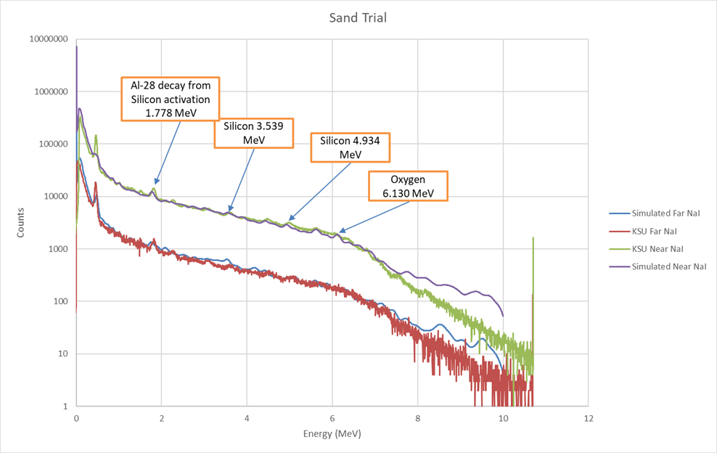
Sand Trial – Background Removed

Slide 23
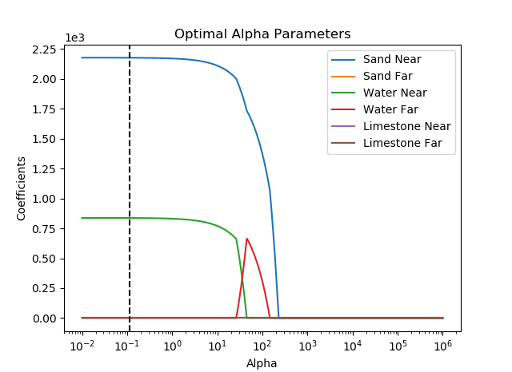
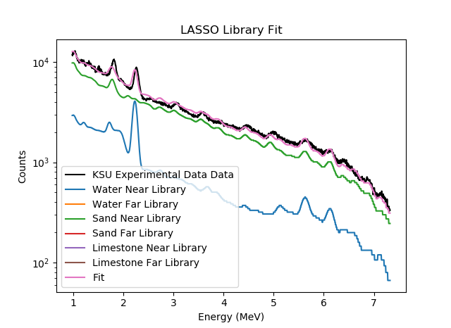
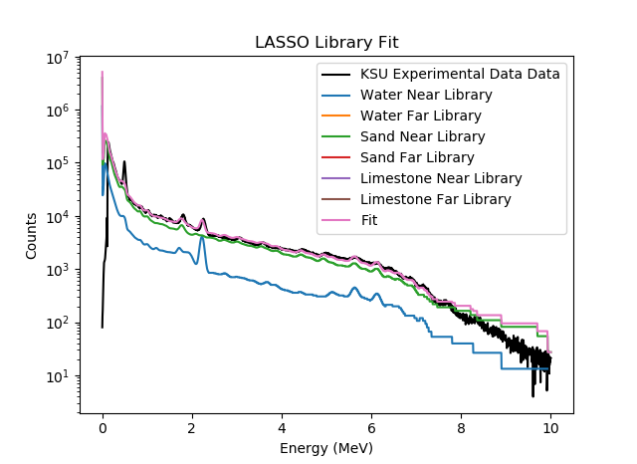
LASSO Water + Sand Experiment Example

Slide 24

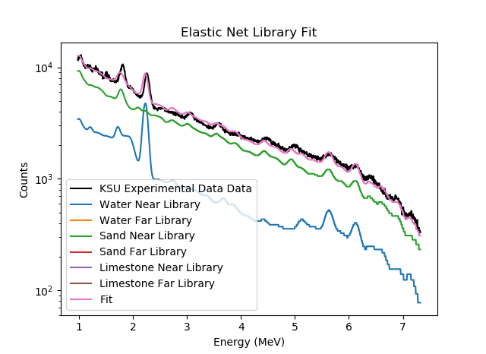
Elastic Net Water + Sand Experiment Example

Slide 25
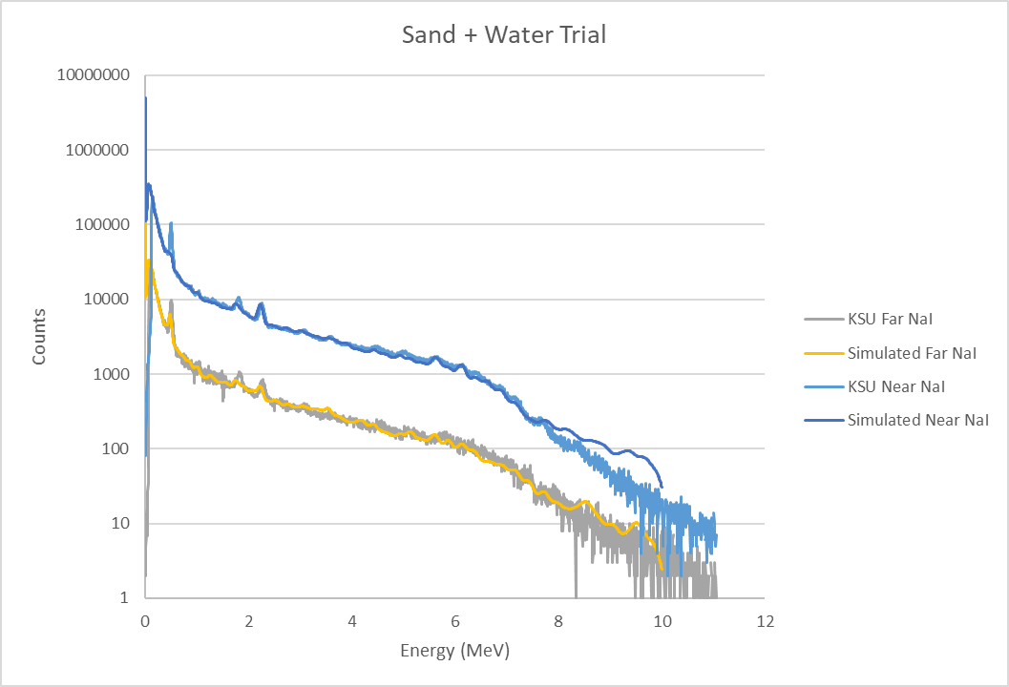
Sand With Water Trial – Background Removed

Slide 26
Continuing Work/Next Steps
Incorporate work from Aaron Feinberg and Long Vo
Bayesian approach to fit all non-linear components
Time dependent digitizer data
Analyze additional trials run at KSU
Limestone
Multiple porosities, water content
Extensive testing of the limitations of LASSO and Elastic Net using simulated radioisotope data
High, medium, low counting situations
Vary number of radioisotopes
Vary number of channels
Shielding situations

Slide 27
References
A.M. Yacout, R.P. Gardner, K. Verghese, Nucl. Instr. And Meth. A 243 (1986) 121.
A.Sood, R.P.Gardner / Nucl. Instr.and Meth.in Phys. Res.B 213 (2004) 100–104
Bob Burkhart, “Neutron Generator and Well Logging”, Sandia National Laboratories, SAND2006-3291C, www.osti.gov/servlets/purl/1264595
Committee on Radiation Source and Replacement, 2008, Radiation Source Use and Replacement, National Research Council, ISBN 0-309-110115-7, National Academies Press, Washington, DC (NAS-2008)
E. Bai, K. Chan, W. Eichinger, P. Kump, “Detection of radionuclides from weak and poorly resolved spectra using Lasso and subsampling techniques. Radiation Measurements, 46 (2011), pp. 1138-1146
Gardner, et al., 2013, ANS Panel on “Recent Developments in Radiation Source Use and Replacement after the NAS Report of 2008”, Transactions of the American Nuclear Society, Vol. 109, 47.
Kump, Paul et al. “Variable selection via RIVAL (removing irrelevant variables amidst Lasso iterations) and its application to nuclear material detection.” Automatica 48 (2012): 2107-2115.
Liberman, A.D et. al., “A method to determine the absolute neutron output of small D-T generator”, Nuclear Instruments and Methods in Physics Research Section B, Volume 79, Issue 1-4, p. 574-578, June 1993
M. Geretschlager, Nucl. Instr. and Meth. B 28 (1987) 289.
MCNP Training Manual
Preston R.M. et al, “Neutron generator burst timing measured using a pulse shape discrimination plastic scintillator with silicon photomultiplier readout”, Journal of Instrumentation, December 8, 2013
R.P. Gardner, A.M. Yacout, J. Zhang, K. Verghese, Nucl. Instr. and Meth. A 242 (1986) 399.
R.L. Heath, Scintillation Spectrometry, Gamma-Ray Spectrum Catalogue, 2nd Ed., USAEC Report IDO-16880, 1964.
T. Papp, J.L. Campbell, D. Varga, G. Kalinka, Nucl. Instr. and Meth. A 412 (1998) 109.
Serra, Oberto. Well Logging Handbook. Ed. Technip, Paris. 2008
Y. Jin, R.P. Gardner, K. Verghese, Nucl. Instr. and Meth. A 242 (1986) 416.

Slide 28
Discussion
Questions?

